Slide 1
Finite Difference Method
Arya HajiTaheri

Slide 2
Outline
Finite Difference Method introduction
Discretization methods
Method
Implicit method
Crank-Nicolson method
Examples
Heat diffusion
Comparison & Summary

Slide 3



What is Finite Difference Method (FDM)?
FDM is a broadly used technique for solving differential equations by approximating them with simpler difference equations.
But how do we get it?
Assume we have a Taylor series expansion
We truncate the expansion to first order only
Separate F’(a) by simple algebra
Assume the error is negligible, therefore the approximation is:
K.W. Morton and D.F. Mayers, Numerical Solution of Partial Differential Equations, An Introduction. Cambridge University Press, 2005.

Slide 4

Finite difference method (Cont.)
While FDM approximates the differential equation, it still yields error.
The error is produced by truncating the solution and by round-off error, the loss of precision due to computer rounding of decimal quantities.
Essentially, it is similar to the derivative of a function plus error:
In this case, the local truncation error is proportional to the step sizes. The quality and duration of simulated FDM solution depends on the discretization equation selection and the step sizes.
An adaptive time step is used to address these two demands. Arieh Iserlas (2008). A first course in the numerical analysis of differential equations. Cambridge University Press. p. 23.

Slide 5
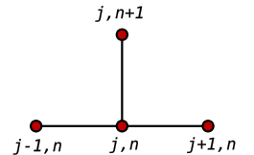

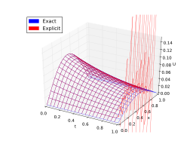
Explicit method
In an explicit numerical method U would be evaluated in terms of known quantities at the previous time step n.
A way to discretized is: u_{j}^{n+1} + u_{j}^{n} / Δt = D* (u^{n}_{j-1} -2u^{n}_{j} + u^{n}_{j+1})/ Δx² + F(x_{j}, t^{n})
Explicit details:
Explicit method is unstable, meaning at λ(D*dt/dx²) > ½ the equation is not accurate anymore.
Because it is conditionally stable.
It has second order accuracy in x, but first order in t.
Hoffman JD; Frankel S (2001). Numerical methods for engineers and scientists. CRC Press, Boca Raton.

Slide 6

Implicit method
Implicit is unconditionally stable, however has same accuracy as the Explicit method. i.e. The errors are linear over the time step and quadratic over the space step.
Implicit discretization: u_{j}^{n+1} + u_{j}^{n} / Δt = D* (u^{n+1}_{j-1} -2u^{n+1}_{j} + u^{n+1}_{j+1})/ Δx² + F(x_{j}, t^{n+1})
Unlike in Explicit method, we cannot solve for the value of u^{n+1} independently, instead we have a system of equations to solve. A tradiagonal matrix is used to solve implicit system of equations.
Hoffman JD; Frankel S (2001). Numerical methods for engineers and scientists. CRC Press, Boca Raton.

Slide 7

Crank-Nicolson method
Conceptually, it is similar to trapezoidal rule.
Crank-Nicolson increases the complexity of the computation however, the solution is much more accurate. E.g both space(Δx) and time(Δt) errors are quadratic.
Crank-Nicolson discretization: u_{j}^{n+1} + u_{j}^{n} / Δt = 0.5D* ((u^{n}_{j-1} -2u^{n}_{j} + u^{n}_{j+1})/ Δx² +(u^{n+1}_{j-1} -2u^{n+1}_{j} + u^{n+1}_{j+1})/ Δx²⁾ + F(x_{j}, t^{n+1})
Crank-Nicolson is also unconditionally stable. Furthermore, it requires tridiagonal matrix to solve for u^{n+1}
Crank, J. The Mathematics of Diffusion. 2nd Edition, Oxford, 1975, p. 143.

Slide 8
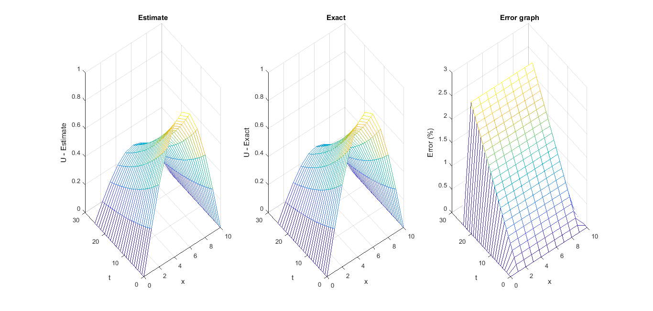


FDM in heat diffusion
Consider a one dimensional heat diffusion equation, with these conditions:
We solve it by approximating all finite spaces,
Majumdar P (2005). Computational methods for heat and mass transfer (1st ed.). Taylor and Francis, New York.
Heat diffusion in two dimensions
Temp
X Y
https://gregjavens.wordpress.com/2016/03/06/2d-heat-diffusion-fdm/

Slide 9
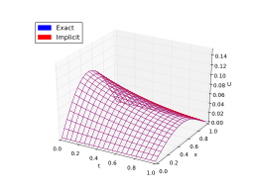
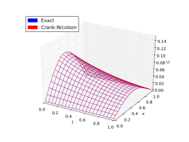
Comparison λ>0.5
Crank-Nicolson
Explicit
implicit
Easiest to implement in a program. Does not need tridagonal matrix.
Can be unstable, and as a result, inaccurate at times.
works the best for large time steps.
It is unconditionally stable.
Cannot solve for u^{n+1} independently.
Crank–Nicolson scheme is the most accurate scheme for small time steps.
It is the most resource demanding compared to other methods.
It is unconditionally stable.

